Slide 1
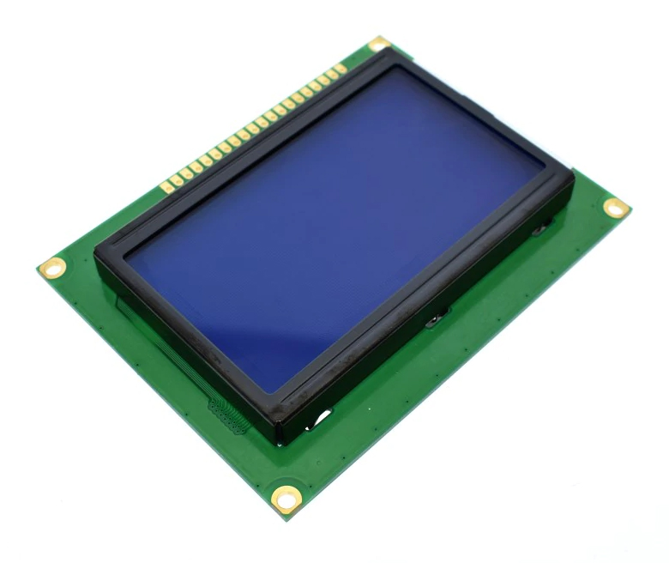
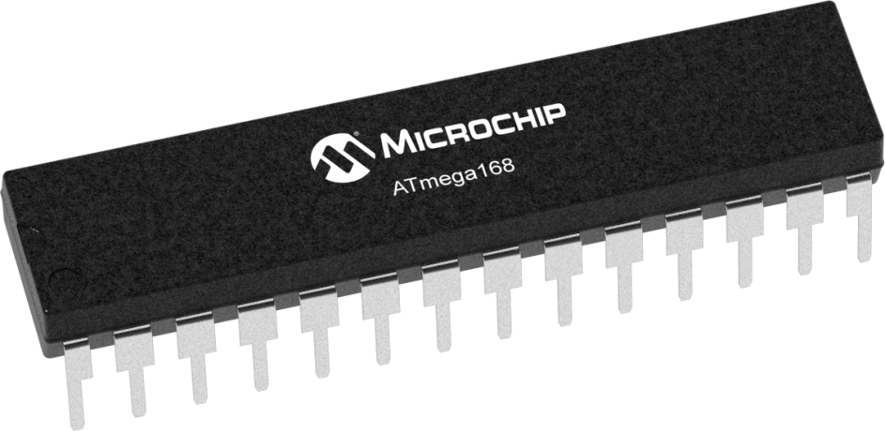
Mini oscilloscope
Pwm signal drawer
Using :
1- ATMega32 Microcontroller
2- GLCD
AMIT Graduation Project
Presented by : Yassein Hamed
D53 online
yasseinhamed67@outlook.sa

Slide 2
Specification
❑ With the graphical LCD we can display the following:
• The shape of the generated PWM from externally
sources.
• The frequency in KHz of the generated wave .
• The duty cycle of the generated wave .
• The time of the single cycle.

Slide 3
Layered architecture
1- Application Layer
App.h
2- Hardware Abstraction Layer
GLCD.h
3- Microcontroller Abstraction Layer
DIO.h PWM.h ICU.h

Slide 4
flowchart
Initialization
Measure Signal
Draw Signal

Slide 5
Measure Signal
Duty = Ton / T ;
ICU_GetSignal();
Clear Input Capture Flag Set
Trigger Edge: RISING_EDG
Period time = B-A
high Time = C-B
Wait for Input Capture →
Set value to A
Wait for Input Capture →
Set value to c
Clear Input Capture Flag Set
Trigger Edge: RISING_EDGE
Clear Input Capture Flag Set
Trigger Edge: Falling_EDGE
Wait for Input Capture →
Set value to B

Slide 6
Draw Signal
Draw_Signal();
GLCD_DisplayString();
repeat
Get duty cycle from ICU
GLCD Line 0: Display Frequency
Value in kHz
GLCD Line 7: Display the PWM
signal shape
GLCD Line 0: Display Duty Cycle
Value in %.
GLCD Line 6: Display Arrow on
First Cycle Period Time
GLCD Line 4: Display Period Time
Value in milliseconds.

Slide 7
Start
Initialization
Get signal
Draw time arrow
loop
sync
stop
continue
End

